Slide 1
Docker and the Microsoft Stack
Docker, .Net and SQL Server

Slide 2

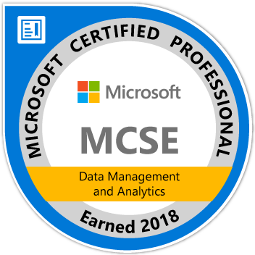
Introduction
Michał Poręba
Explorer DBA in Wales MCSE: Data Management and Analytics Senior DBA at Vizolution in Swansea
https://dbain.wales https://twitter.com/michalinwales

Slide 3
Docker Containers
March 2013 – Initial release
April 2019 – Version 18.09.5 released

Slide 4
Demo 1
SQL Server in a Container

Slide 5
Demo 1
The Good bits
The Not So Good
SQL Server runs in a container
Deploying SQL in a container is fast
Multiple instances and versions
A bit more complex
Back to SQL Authentication

Slide 6
But Windows?
Isn’t Linux Better for Containers?

Slide 7
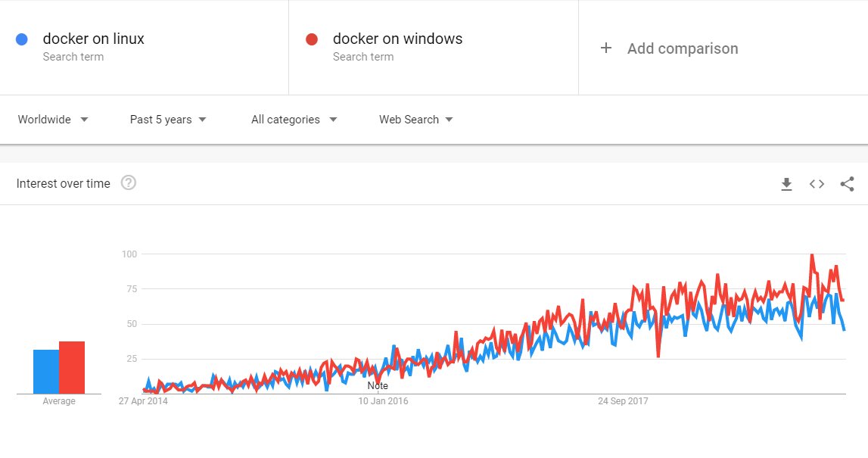

Slide 8
Demo 2
The Test WebAPI on Windows

Slide 9
Containers for .net (Windows) Developers
Get the latest services without installation
Run Linux services on your Windows workstation
Test applications in isolation
Test with services in different versions without conflicts
Easily move preconfigured application between environments

Slide 10
And what if the SYSADMIN says NO?
As long as you can install Docker for Windows you are fine
Just give it a go
There is no need to use containers in production to get some benefits of containerization
It just works. It is that simple.

Slide 11
Containers for .net (Windows) Teams
Easily set up test environments
Quickly deploy your services in a specific version
Test your systems with confidence
Automate internal deployments (DEV, TEST, UAT)
Automate integration tests

Slide 12
And what if the SYSADMIN says NO?
You may want to avoid orchestration to have fewer questions to answer, and fewer problems too
This time cooperation might be necessary but…
Communication between the services is internal to docker, so you will be in control.
All docker hosts can run Windows OS
All docker hosts can be part of Windows Domain which they control
It’s not for production

Slide 13
Containers On Windows for PRODUCTION
Here is where the real problems start!
Probably you have existing infrastructure to consider
Dockerized applications need to connect to existing services

Slide 14
Demo 3
SQL Server FROM a Container

Slide 15
Let’s talk Security
Docker Hosts can be joined to AD domain
But containers are not
SQL and SSPI (Security Support Provider Interface)
gMSA
Credential Spec Files

Slide 16
Demo 3 part 2
SQL Server FROM a Container using gmsas

Slide 17
Let’s talk Orchestration
Deployment
Management
Networking
Scaling
Availability

Slide 18
Container Orchestration Options
Docker Swarm (mode)
Kubernetes
2014 – Docker
Manager and Worker Nodes
Tasks and Services
2014 – Google
Control Plane and Workers
Pods and Services

Slide 19
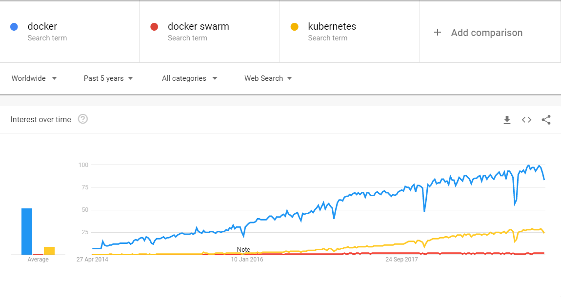

Slide 20
Container Orchestration ON WINDOWS
Docker Swarm
Kubernetes
Docker 1.13
Windows 10 or Server 2016+
Kubernetes 1.14 (March 2019)
Docker EE-Basic 18.09
Windows Server 1809
Control Plane on Linux

Slide 21
Let’s talk Networking
Localhost might not be what you think
MTU on VMs!

Slide 22
Let’s talk SQL Server
SQL Server executable is the same on Windows and Linux
SQL Server is supported in Linux containers
but is not supported in Windows containers for production deployments!
In pre-production environments it works well

Slide 23
SO what if the SYSADMIN STILL says NO?
If we are talking about production,
they might be right…

Slide 24
Thank you
Presentation: https://bit.ly/2XQ4k79
My blog: https://dbain.wales
Twitter: @michalinwales
Questions?

